Slide 1
Learning Big Data
Aditya Konda
Big Data Engineer

Slide 2
Content
Hadoop
Introduction to Hadoop
Hadoop Characteristics
Hadoop Eco System
Hadoop Architecture
Hadoop core components
HDFS
NameNode, DataNodes and Block Replication
DataNodes and Block Replication Architecture & HDFS Architecture
Map Reduce
Map-Reduce Architecture
Map-Reduce Example

Slide 3
Introduction to Hadoop.
Apache Hadoop is an open-source framework.
Storing and processing massive data-set on a cluster.
Java-based programming Language.

Slide 4
Hadoop Characteristics
Open source
Distributed processing and Distributed storage
Scalable
Reliable
Fault-tolerant
Economical
Flexible

Slide 5
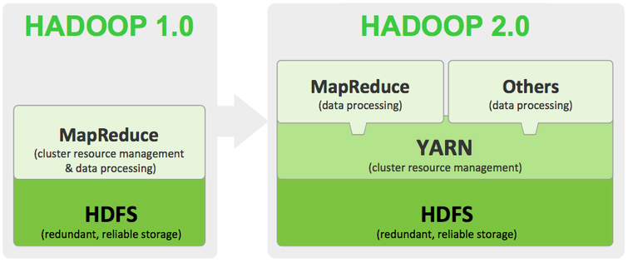
Hadoop Architecture

Slide 6

Hadoop Distributed File System (HDFS)
Run on commodity hardware
Can hold massive data
Data shared across nodes
Data is Replicated to rescue data lose
NameNode and DataNodes

Slide 7
NameNode and DataNode
Master/Slave Architecture
Single NameNode Many DataNodes
NameNode stores Metadata
Single point of failure
Secondary NameNode
Single Node Cluster, NameNode and DataNode resides on the same machine.

Slide 8
DataNodes and Block Replication
DataNodes perform read-write operations.
DataNode perform operation on Blocks given by NameNode.
Blocks:
stores each file as a sequence of blocks
All blocks are same in size except the last one
Block are replicated for fault-tolerance
Number of replicated block are decided by NameNode

Slide 9
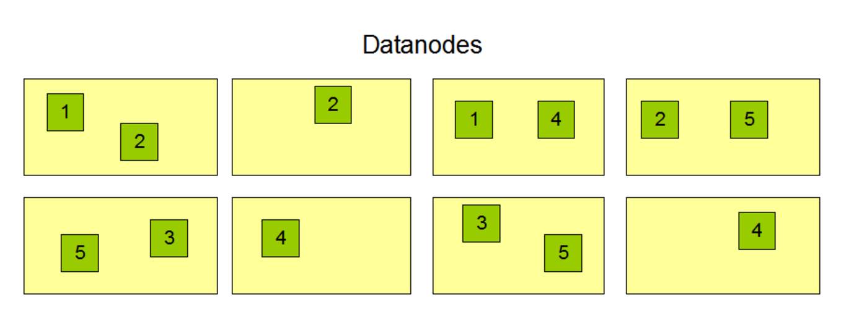
DataNodes

Slide 10


Slide 11
Map-Reduce
Map-Reduce job proceeds in two phases. MAP phase and REDUCE phase
For large-scale data processing
Exploits large set of commodity computers
Executes process in distributed manner
Offers high availability
The inputs and outputs for each phase are a set of key-value pairs.

Slide 12
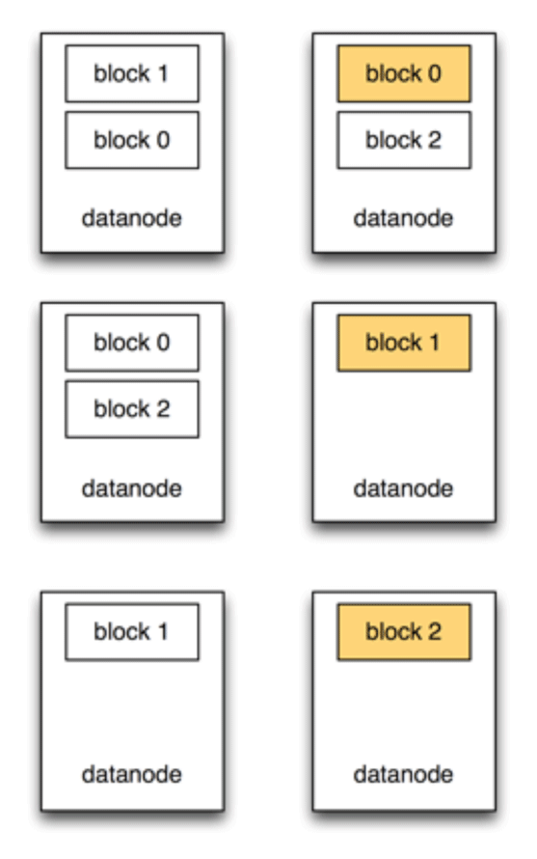
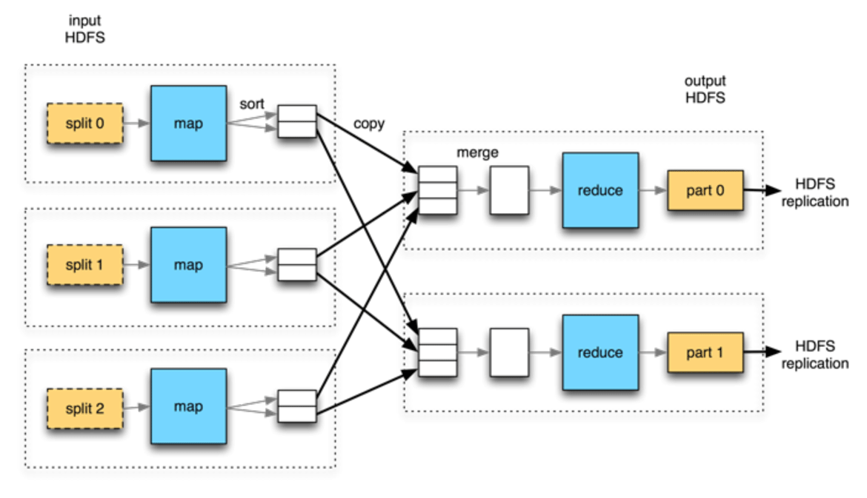
Map-Reduce Architecture

Slide 13
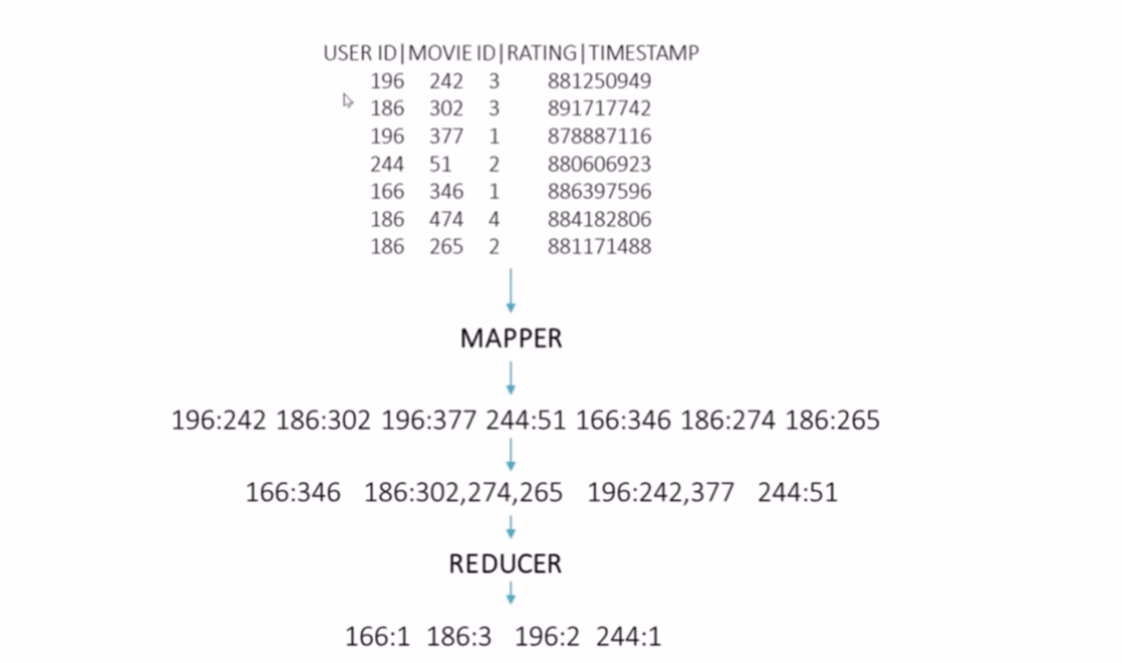
Map- Reduce Example

Slide 14
References
Scaling Nodes Vertically and horizontally
Hadoop Introduction Tutorial
Hadoop eco-system and its components
NameNode and DataNode
HDFS Architecture:
Map-Reduce

Slide 15


